Slide 1




Slide 2


ASME IDETC2023 Hackathon – Autodesk Problem:
Automating Material Selection for Product Design
Lequn Chen
Contact: chen1470@e.ntu.edu.sg
Advanced Remanufacturing and Technology Centre (ARTC), A*STAR, Singapore
Nanyang Technological University, Singapore
Notes:
Good afternoon, professors, and distinguished guests. My name is Lequn, and I am a PhD candidate from Nanyang Technological University. Today, I’m glad to present my paper, "Multimodal Sensor Fusion For Real-time Location-dependent Defect Detection In Laser-directed Energy Deposition"

Slide 3
01
Dataset Analysis
02
Feature Engineering
02
Dimensionality reduction
CONTENTS
03
ML Modelling
04
Results and Discussion
05
Future Works
Notes:
My presentation will follow this outline: introduction and background information, including the research gaps and objectives, the proposed methodologies and preliminary results and discussions, and future research directions.

Slide 4
1. Dataset Analysis
Assembly JSON file hierarchical structure
Keys: (['tree', 'root', 'occurrences', 'components', 'bodies', 'as_built_joints', 'contacts', 'holes', 'properties'])
Properties:
Assembly level information
['name', 'bounding_box', 'vertex_count', 'edge_count', 'face_count', 'loop_count', 'shell_count', 'body_count', 'area', 'volume', 'density', 'mass', 'center_of_mass', 'principal_axes', 'xyz_moments_of_inertia', 'surface_types', 'vertex_valence', 'design_type', 'likes_count', 'comments_count', 'views_count', 'products', 'categories', 'industries’])
Bodies:
Individual Component level information
{'name': 'Body7', 'type': 'BRepBody', 'png': 'e397626e-0608-11ec-a470-02052889e3af.png', 'smt': 'e397626e-0608-11ec-a470-02052889e3af.smt', 'step': 'e397626e-0608-11ec-a470-02052889e3af.step', 'obj': 'e397626e-0608-11ec-a470-02052889e3af.obj', 'physical_properties': {'center_of_mass': {'type': 'Point3D', 'x': 0.25315821192952176, 'y': 0.03333797923237883, 'z': 2.7849977545097624}, 'area': 19.067095914836415, 'volume': 1.128564254878852}, 'material_category': 'Plastic'}

Slide 5
1. Dataset Analysis
Names of the bodies
Contains characters from foreign languages: しっぽ , Piastra (plate), Vite Piedino (Foot screw)
Easy to understand names: leg_motor, iron cardin, Brass Pattern, L-Bracket,screw
Some abstract names: Body10, Body59, Body2, …..

Slide 6
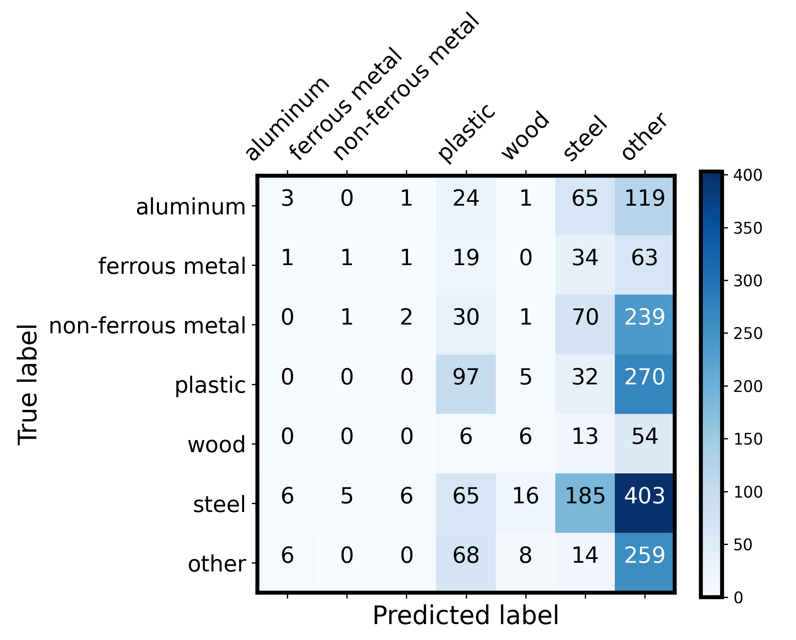
Baseline Model performance – GPT3.5 + only “name” in the prompt

Slide 7
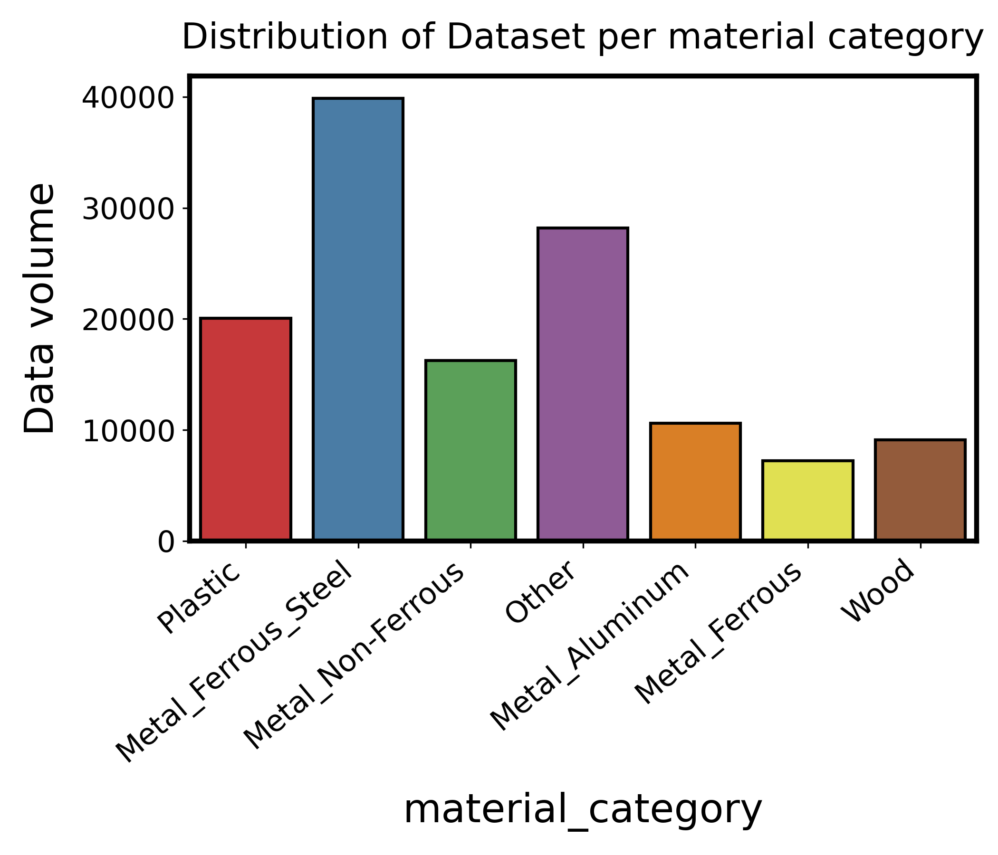
1. Dataset Analysis (Training set)
Notes:
Dataset is imbalanced
Need to consider this factor during the modelling process.

Slide 8
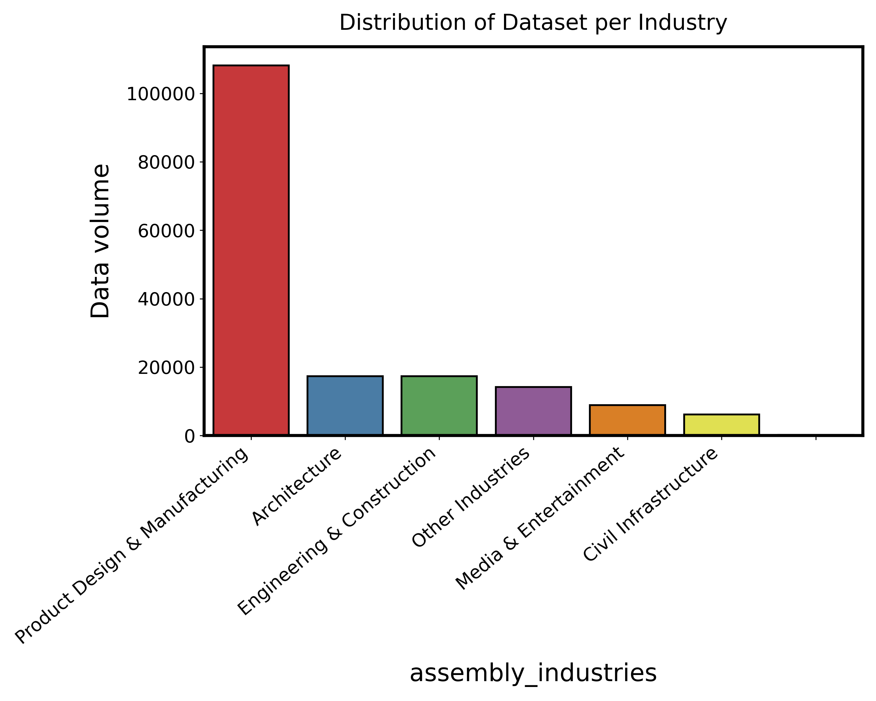
1. Dataset Analysis (Training set)
Notes:
Categorical Data.
Multi-label Binarization for multiple categorical features

Slide 9
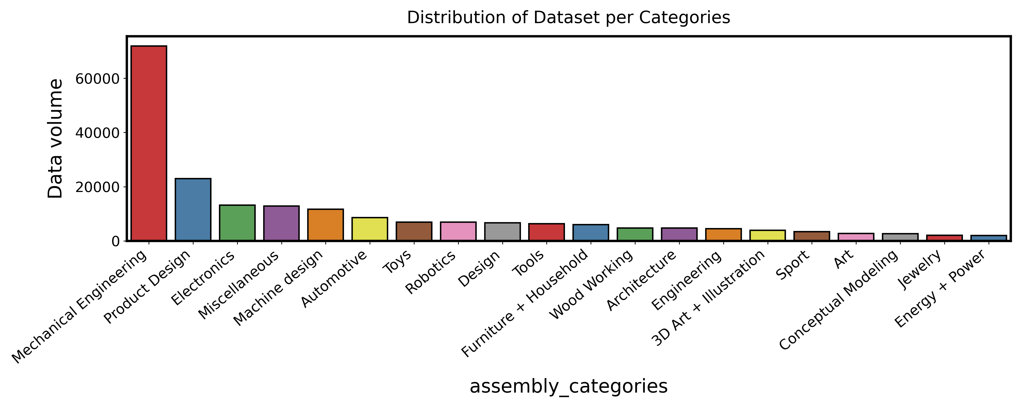
1. Dataset Analysis (Training set)

Slide 10
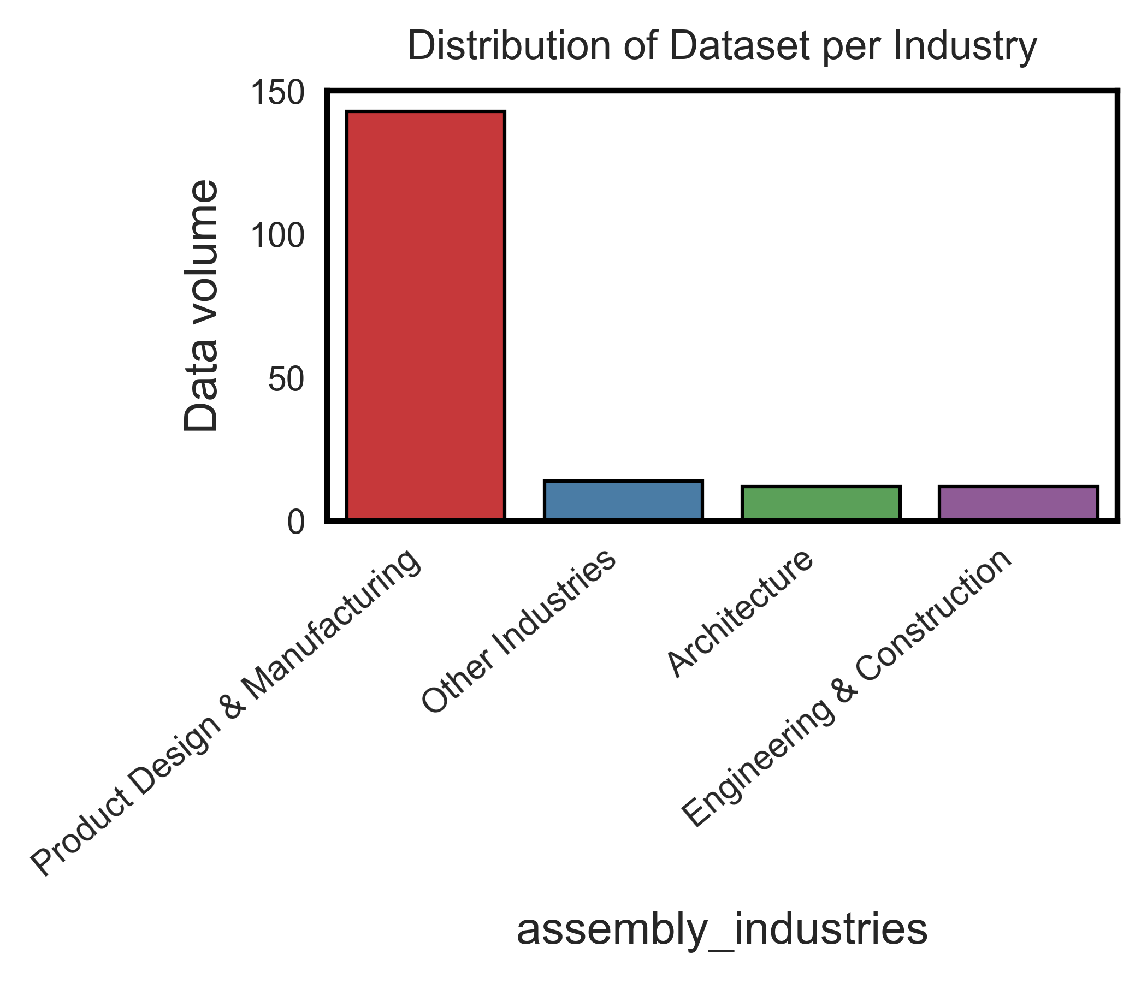
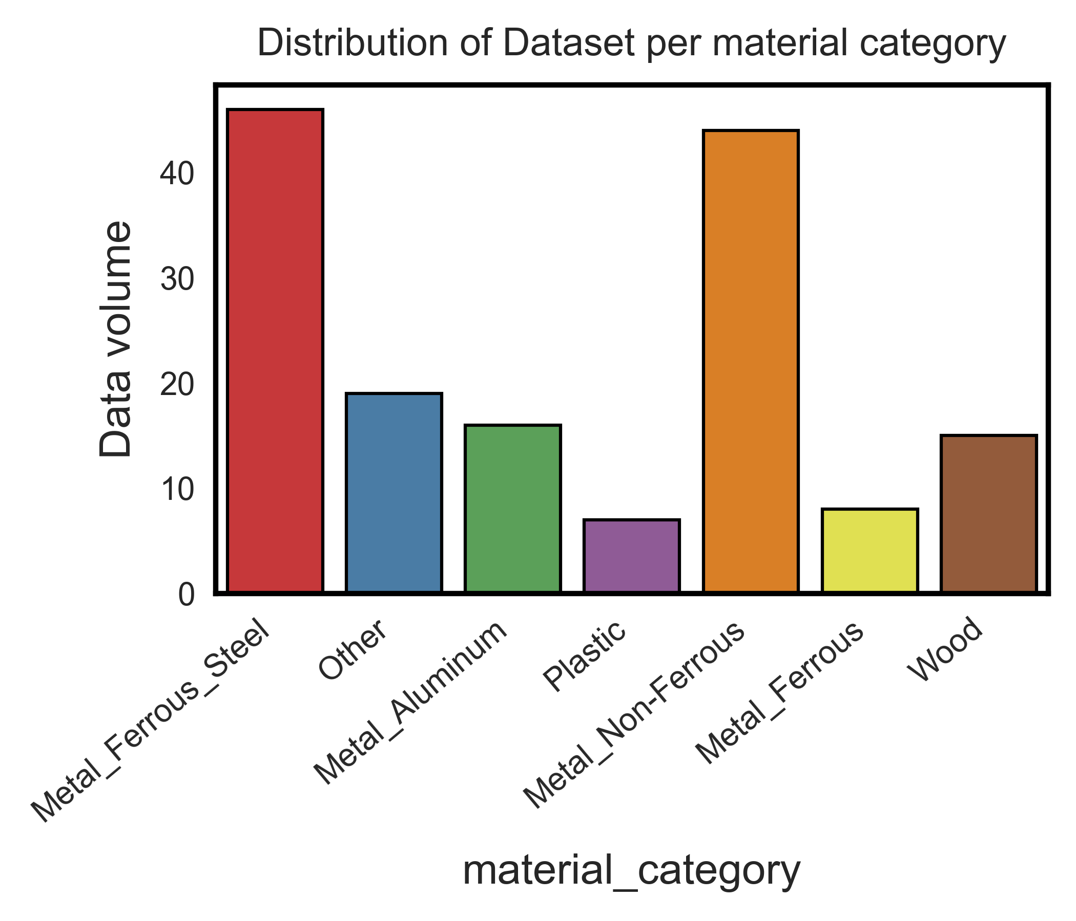
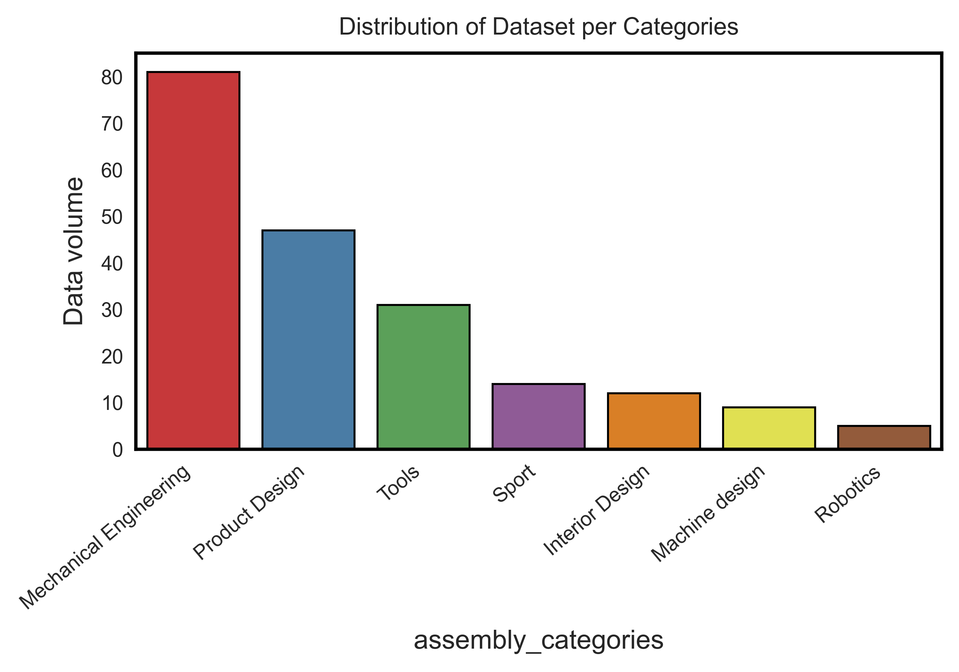
1. Dataset Analysis (Test set)
Test set has fewer industries, categories.
This means there could be a distribution shift.

Slide 11
2. Feature Engineering
Physical Properties: Area, mass, density, and moments of inertia (xx, yy, zz, xy, yz, xz), etc; Different materials will have distinct densities and mass distributions.
Geometry Information:
- Bounding Box Dimensions
- Vertex count, Edge count, Face count, Loop count, Shell count, Body count: These counts can give an idea about the complexity of the geometry.
- Surface Types: The types of surfaces (e.g., cylindrical, planar, toroidal) and their counts can provide insights into the manufacturing processes suitable for the part, which in turn might hint at the material.
Design Information:
- Design Type: Whether the design is parametric, or some other type might influence material choice.
Metrics: While these metrics (likes, comments, views) might not directly influence the material, they might correlate with certain material choices (popularity) if popular designs tend to use specific materials.
Notes:
A breakdown of potentially useful information:
1. Physical Properties: The physical properties of the body, such as mass, density, and moments of inertia, can be informative. Different materials will have distinct densities and mass distributions.
- Area
- Volume
- Density
- Mass
- Moments of Inertia (xx, yy, zz, xy, yz, xz)
2. **Geometry Information**: The geometric complexity and shape of a part can sometimes hint at the material. For instance, intricate geometries might be made of materials that are easy to mold or machine.
- Bounding Box Dimensions: The difference between the max and min points on each axis can give the size in x, y, and z directions.
- Vertex count, Edge count, Face count, Loop count, Shell count, Body count: These counts can give an idea about the complexity of the geometry.
- Surface Types: The types of surfaces (e.g., cylindrical, planar, toroidal) and their counts can provide insights into the manufacturing processes suitable for the part, which in turn might hint at the material.
3. **Design Information**:
- Design Type: Whether the design is parametric or some other type might influence material choice.
4. **Engagement Metrics**: While these metrics (likes, comments, views) might not directly influence the material, they might correlate with certain material choices if popular designs tend to use specific materials.

Slide 12
2. Feature Engineering
Categories and Industries: The industry and category the design is intended for can be a strong hint. For instance, designs in the "Aerospace" category might prefer lightweight and strong materials like titanium or composite materials.
Derived Features: Some features can be derived from the existing data to enhance its expressiveness. For instance:
- Aspect Ratios: Derived from the bounding box dimensions, they can indicate if a part is elongated, flat, or almost cubic, which might influence material choice.
- Complexity Metrics: Ratios like vertex-to-edge count, face-to-loop count, etc., can be indicative of the overall complexity of the design.
- Volume fraction: Body volume divided by the assembly volume. Large volume fraction could indicate primary component and might be made of a material suitable for bearing loads or stresses. Conversely, small volume fractions might represent accessory or supplementary components.
Notes:
5. **Categories and Industries**: The industry and category the design is intended for can be a strong hint. For instance, designs in the "Aerospace" industry might prefer lightweight and strong materials like titanium or composite materials.
6. **Derived Features**: Some features can be derived from the existing data to enhance its expressiveness. For instance:
- **Aspect Ratios**: Derived from the bounding box dimensions, they can indicate if a part is elongated, flat, or almost cubic, which might influence material choice.
- **Complexity Metrics**: Ratios like vertex-to-edge count, face-to-loop count, etc., can be indicative of the overall complexity of the design.
- The volume fraction can indicate the significance or size of a component relative to the entire assembly. If a component occupies a significant portion of the assembly, it may hint that the component is primary and might be made of a material suitable for bearing loads or stresses. Conversely, small volume fractions might represent accessory or supplementary components.
7. **Components and Hierarchical Structure**: The relationships between components can be meaningful. If certain sub-components are made of a specific material, it might influence the material choice of the main body. However, this requires a more complex modeling approach to take hierarchy into account.

Slide 13
2. Feature Engineering
Derived feature:
Center of mass distance: the Euclidean distance between the body's center of mass (COM) and the assembly's COM. → how the material is distributed within the assembly; gives an indication of how central or peripheral a body is within the assembly.
Components and Hierarchical Structure: The relationships between components can be meaningful. If certain sub-components are made of a specific material, it might influence the material choice of the main body. However, this requires a more complex modeling approach to take hierarchy into account. → potentially need to use knowledge graph to model the relationship
Notes:
5. **Categories and Industries**: The industry and category the design is intended for can be a strong hint. For instance, designs in the "Aerospace" industry might prefer lightweight and strong materials like titanium or composite materials.
6. **Derived Features**: Some features can be derived from the existing data to enhance its expressiveness. For instance:
- **Aspect Ratios**: Derived from the bounding box dimensions, they can indicate if a part is elongated, flat, or almost cubic, which might influence material choice.
- **Complexity Metrics**: Ratios like vertex-to-edge count, face-to-loop count, etc., can be indicative of the overall complexity of the design.
- The volume fraction can indicate the significance or size of a component relative to the entire assembly. If a component occupies a significant portion of the assembly, it may hint that the component is primary and might be made of a material suitable for bearing loads or stresses. Conversely, small volume fractions might represent accessory or supplementary components.
7. **Components and Hierarchical Structure**: The relationships between components can be meaningful. If certain sub-components are made of a specific material, it might influence the material choice of the main body. However, this requires a more complex modeling approach to take hierarchy into account.

Slide 14
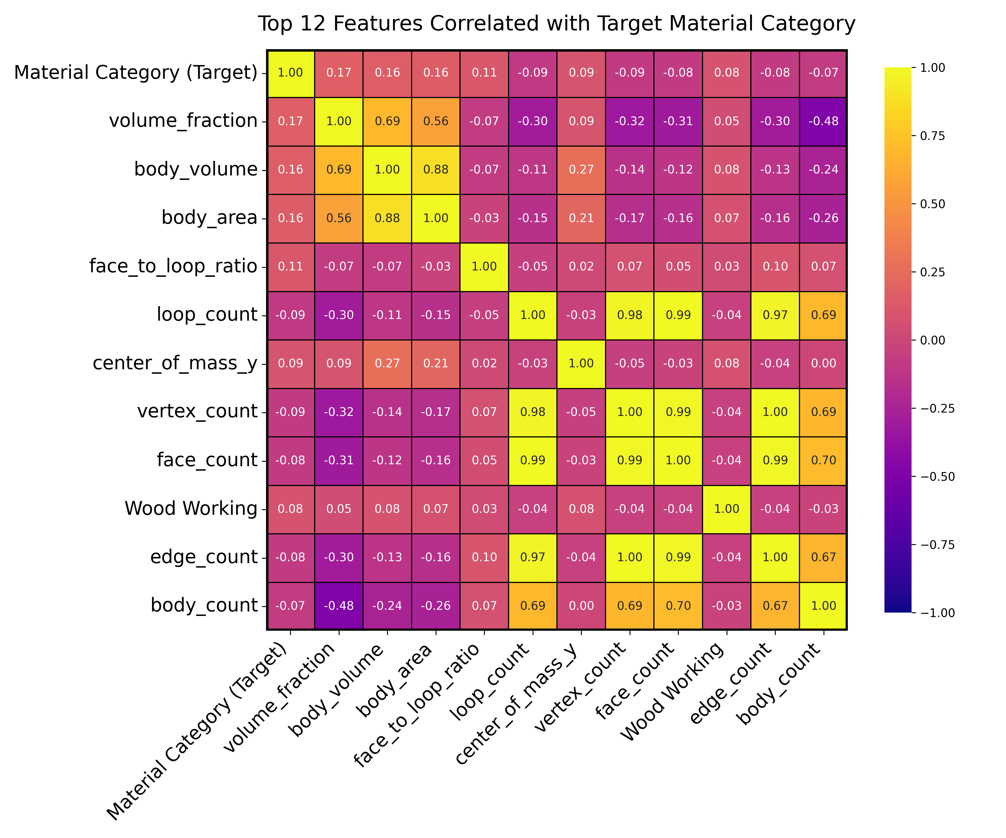
2. Feature Engineering – Spearman's Rank Correlation matrix
The relationship between variables might not be strictly linear, Spearman’s matrix is chosen rather than Pearson correlation matrix to evaluate the feature correlation
Multicollinearity: highly correlated independent variables can lead to multicollinearity, which might make the model unstable. → need to identify
Feature Importance: By looking at the correlation of each feature with the target variable, we can get the importance or influence of each feature on the target.
Notes:
Top Correlated Features with Target: Visualize only the top N features that have the highest absolute correlation with the target variable. This focuses on the most influential features.
Pearson measures the strength and direction of the linear relationship between two variables.
Spearman measures the strength and direction of the monotonic relationship between two variables.
Hierarchical Clustering Heatmap: This approach groups correlated features together in a heatmap. By clustering features that are similar, you can more easily digest the information.
Pairwise Scatter Plots for Selected Features: For features that seem particularly interesting or unexpected, plot them pairwise with the target variable or other features. This provides a more detailed view of relationships.
Dimensionality Reduction: Techniques like PCA (Principal Component Analysis) can be used to reduce the dimensionality of your data. This won't directly help with correlation visualization, but it can simplify your dataset and capture most of the variance in fewer principal components. You can then visualize these principal components.

Slide 15
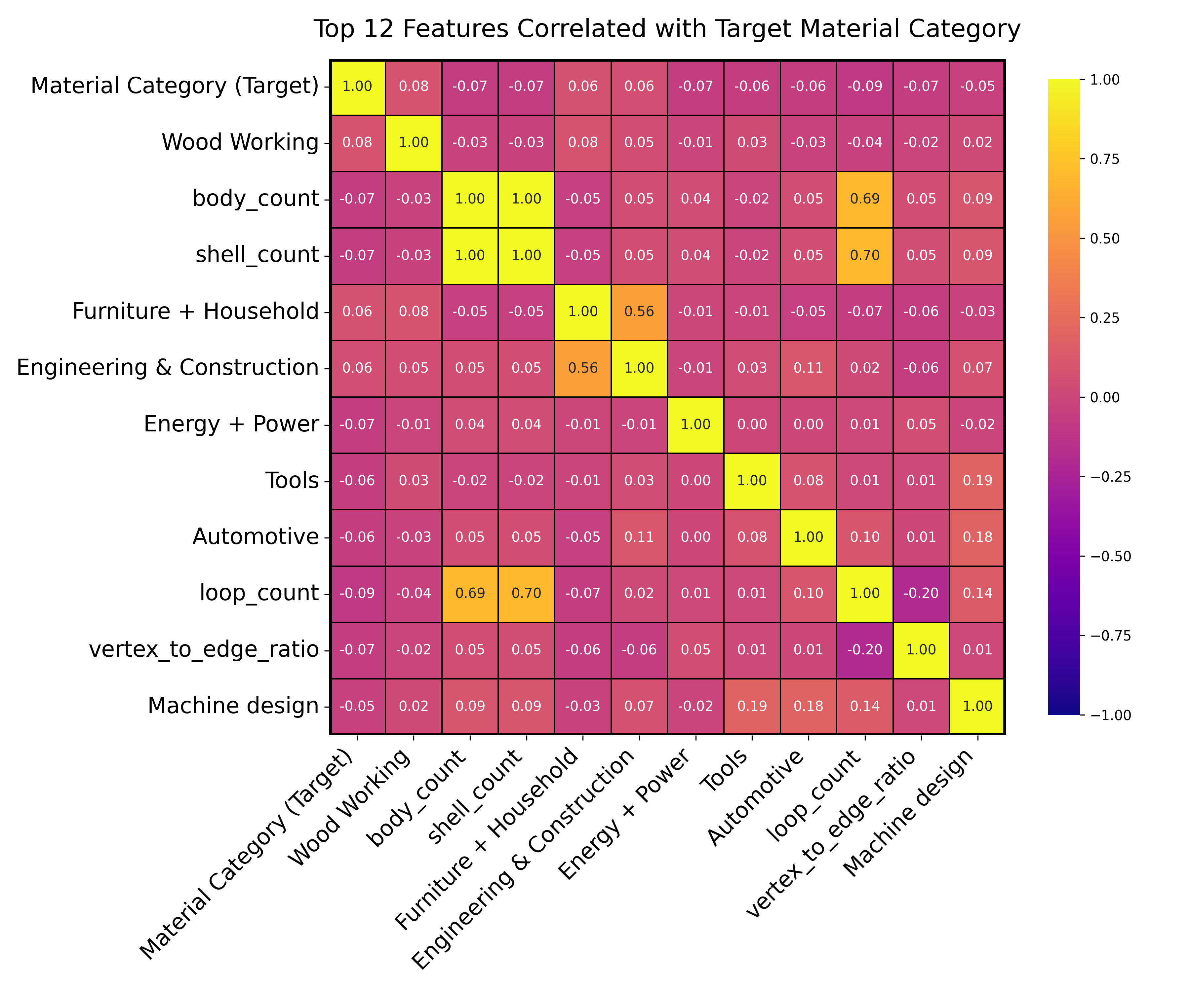
2. Feature Engineering – Pearson’s Rank Correlation matrix
Inspect the linear relationship between the features, and the target.
We can see that most of these features does not have strong influence on the target output.
Notes:
Pearson measures the strength and direction of the linear relationship between two variables.
Spearman measures the strength and direction of the monotonic relationship between two variables.

Slide 16
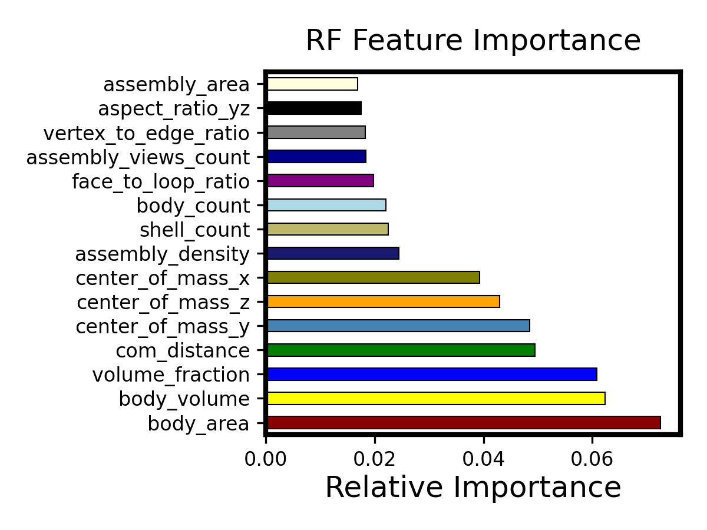
2. Feature Engineering – RF feature importance ranking
The features that are most influential in making predictions.
The highest importance in our case is around 0.08, which is low.
It means even a small importance score can be significant.
Notes:
Pearson measures the strength and direction of the linear relationship between two variables.
Spearman measures the strength and direction of the monotonic relationship between two variables.

Slide 17
2. Feature Engineering – Correlation matrix
Observations:
Weak Correlation: This suggests that the relationship between these features and the target might be complex and highly non-linear.
linear models (like linear regression) may not perform well
more complex models that can capture non-linearities (e.g., decision trees, random forests, or neural networks) might be effective.
there's room for more feature engineering or to derive features or external features could be beneficial for prediction.
Inherent Complexity

Slide 18
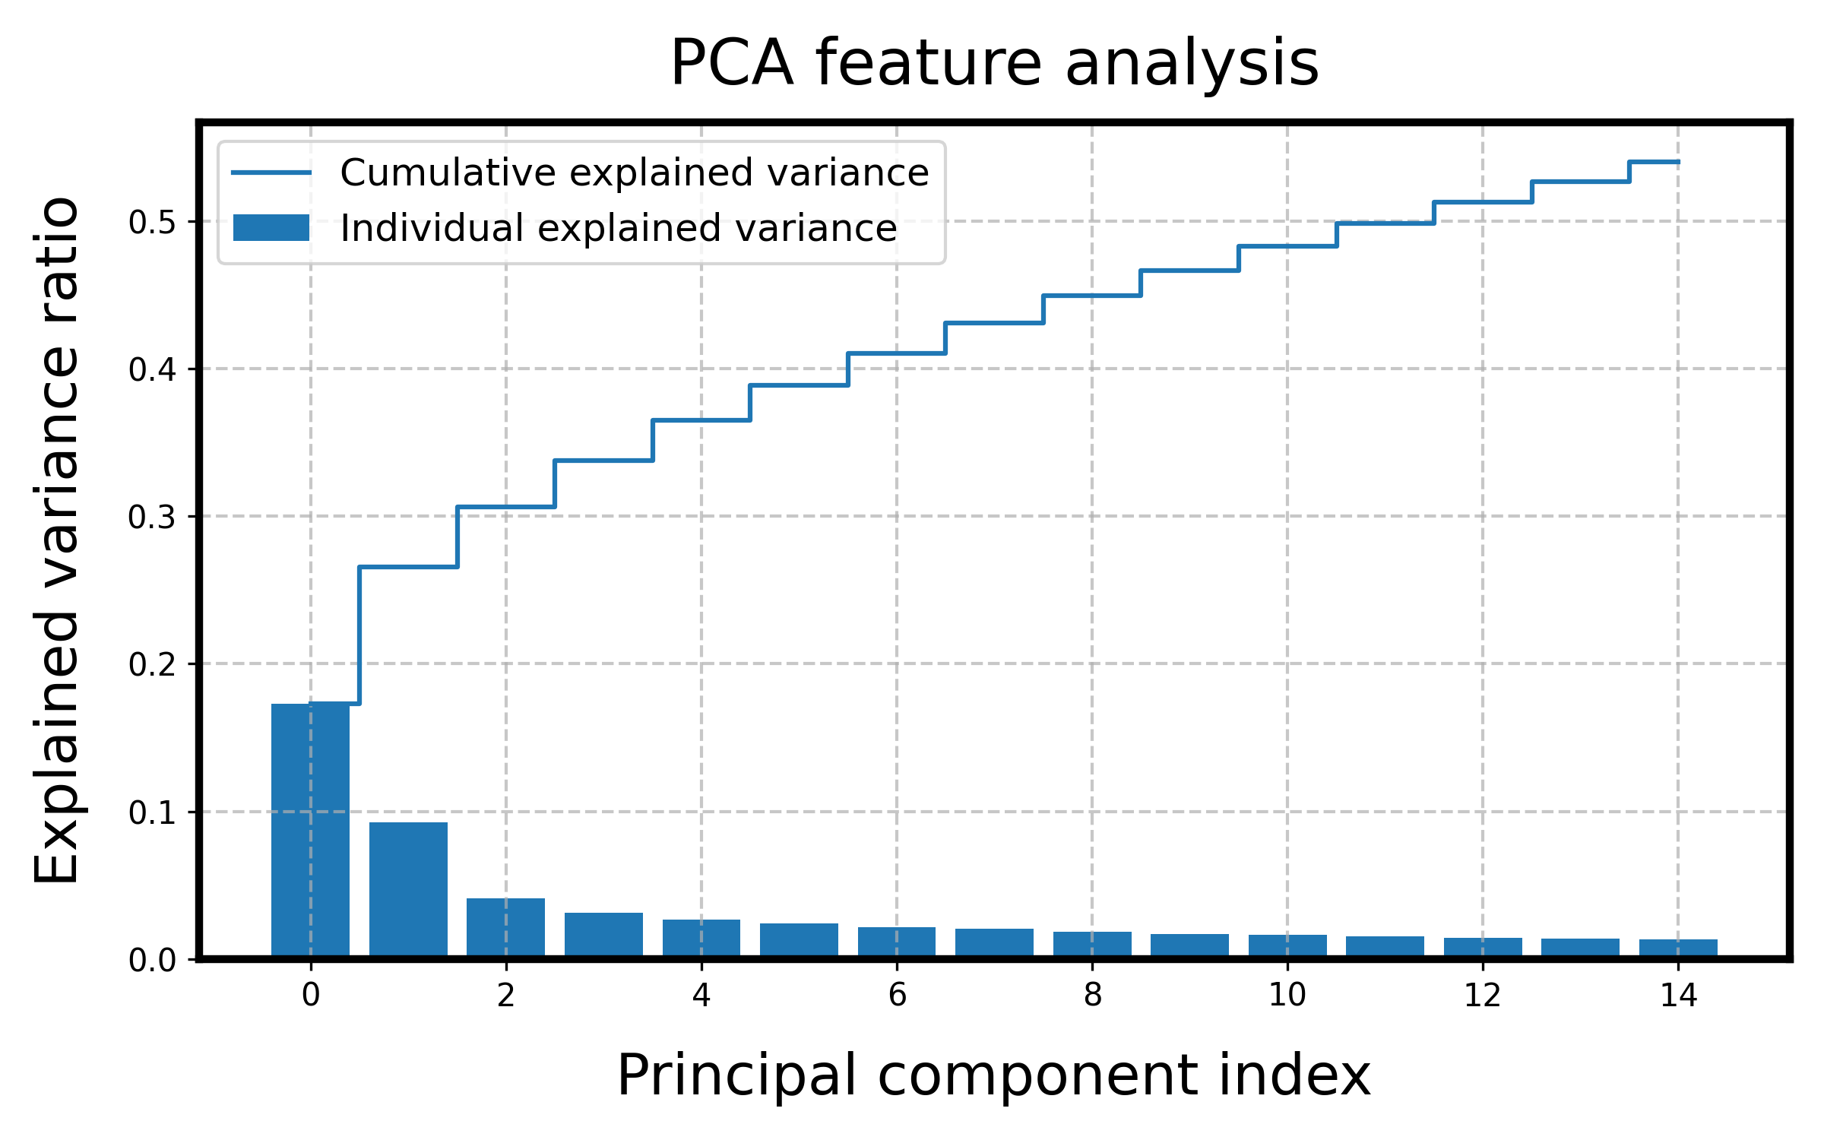
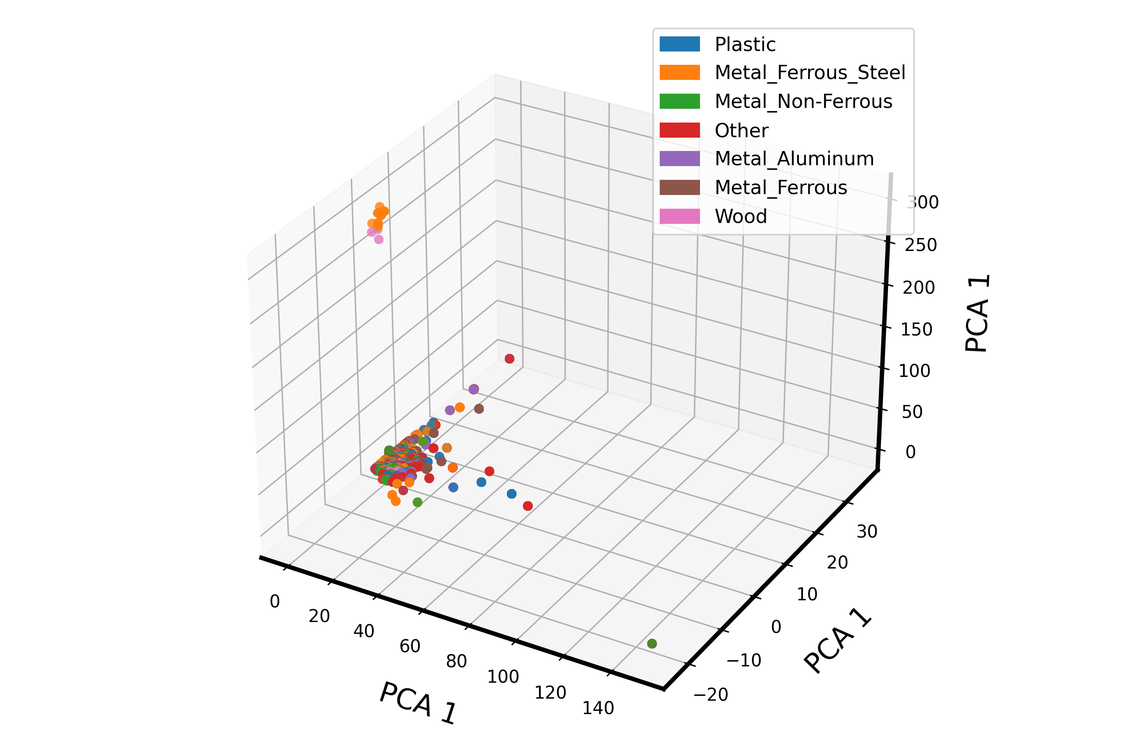
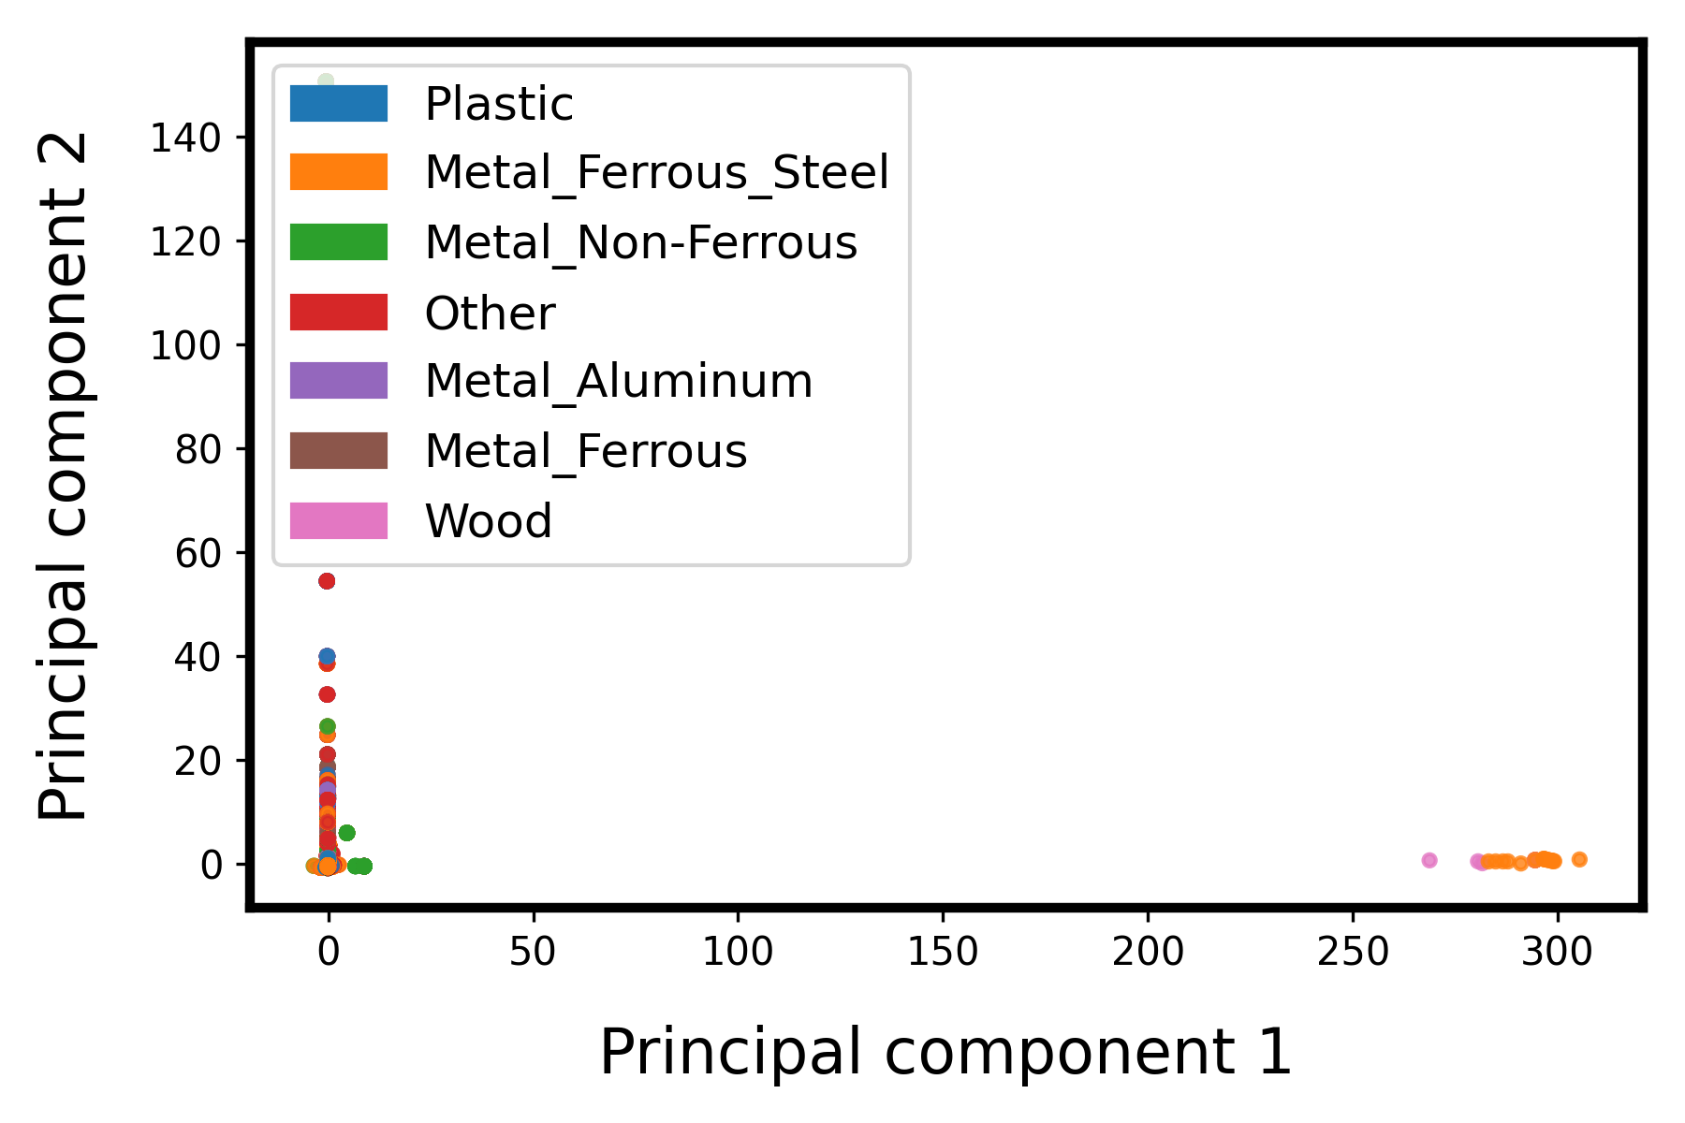
3. Visualization and dimensionality reduction

Slide 19
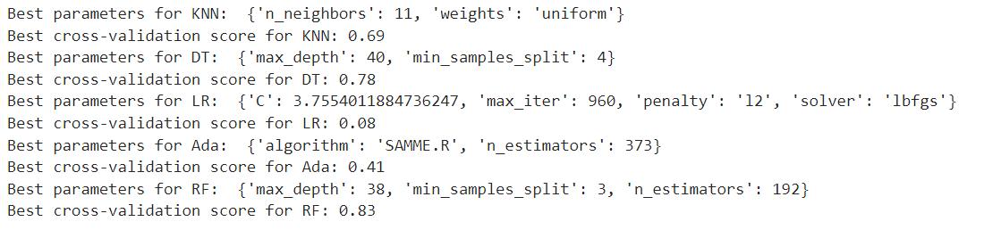
3. ML modelling
General Procedure:
Train-validation split = 8:2
Selected models: RF, DT, KNN, Logistic Regression
5-fold cross-validation for hyperparameter tuning
Initial tuning with RandomSearchCV
Fine-tuning: GridSearchCV
Best hyperparameter is used to train the model on the training set
The trained model is used to make inference on the testing set.

Slide 20
3. ML modelling: Regularization and pruning (prevent overfitting)
Hyperparameter tuning:
1. KNN:
- Complexity Control: k - the number of neighbours. A small k can lead to a noisy model (overfitting), while a large k can lead to a too smooth model (underfitting).
- Distance Metric: Euclidean, Manhattan. Weighted KNN, where closer neighbours have a bigger influence, can also be considered.
2. Decision Trees (DT):
- Pruning: setting a limit on the maximum depth, minimum samples at a leaf, or minimum samples to split a node. → prevents the tree from growing too deep, which can lead to overfitting.
- Regularization: The `ccp_alpha` parameter used for Minimal Cost-Complexity Pruning. A higher `ccp_alpha` prunes more of the tree.

Slide 21
3. ML modelling: Regularization and pruning (prevent overfitting)
Hyperparameter tuning:
3. Random Forest (RF):
- Tree Depth and Leaf Samples: control the maximum depth of the trees in the forest or set a minimum number of samples required to be at a leaf node.
- Number of Trees: More trees increase the robustness of the model at the cost of computational efficiency. But after a certain point, adding more trees doesn't improve performance significantly.
- Features per Split: setting the `max_features` parameter to control how many features are considered for each split. This introduces randomness and can help in reducing overfitting.
- Out-of-Bag (OOB) Score: The OOB score can be used as an approximation to the validation error without a separate validation set. If the OOB error is much lower than the test error, it might indicate overfitting.

Slide 22
3. ML modelling: Dealing with imbalanced dataset
Stratified Split: ensures that the train and validation sets have approximately the same percentage of samples of each target class as the complete dataset.
Using class_weight: during the hyperparameter tuning phase (i.e., within RandomizedSearchCV or GridSearchCV) and during final training. This will ensure that during both phases, the classifier is taking into account the imbalances in the class distribution.
Evaluation Metrics during Hyperparameter Tuning: choose F1 score (F1 weighted) instead of accuracy.
"f1_macro": Calculate metrics for each label and find their unweighted mean.
"f1_weighted": Calculate metrics for each label, and find their average weighted by support (the number of true instances for each label).

Slide 23
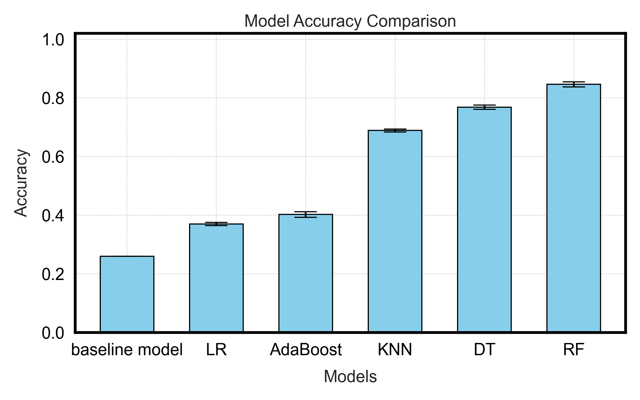
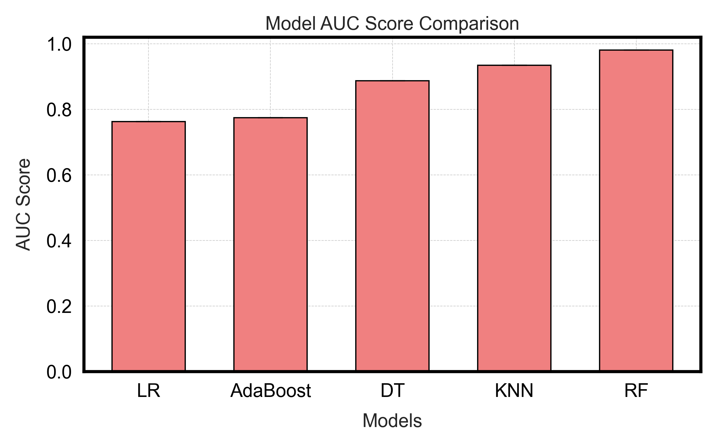
4. Results and Discussions
Best performance on the validation set was achieved by the Random Forrest Classifier (~84%).
RF also has the highest AUC score
All models with the selected features obtained higher accuracy than the baseline model

Slide 24
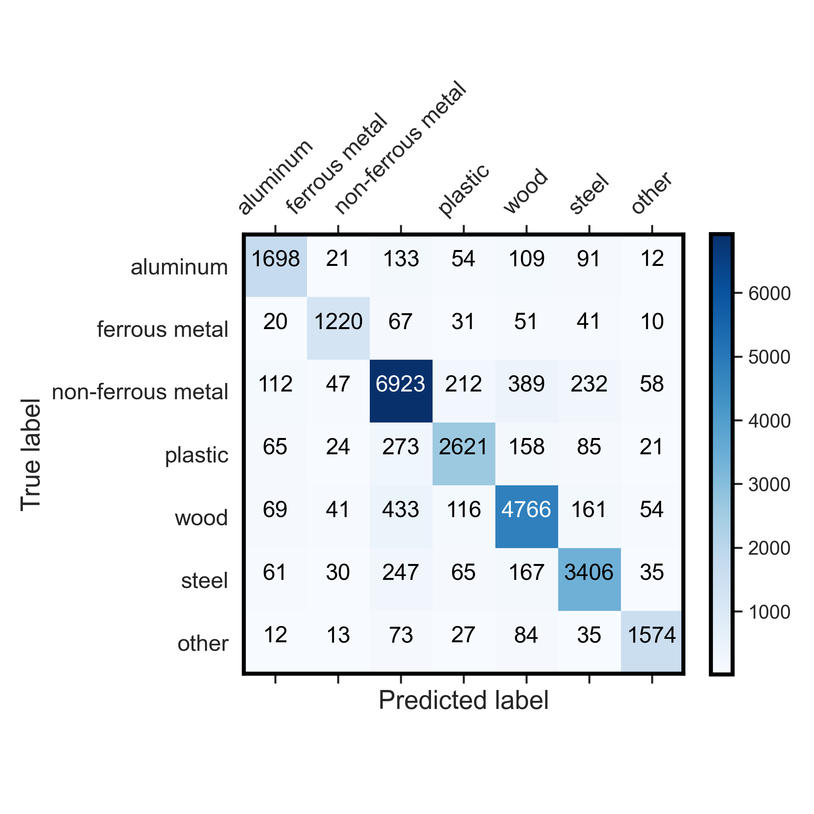
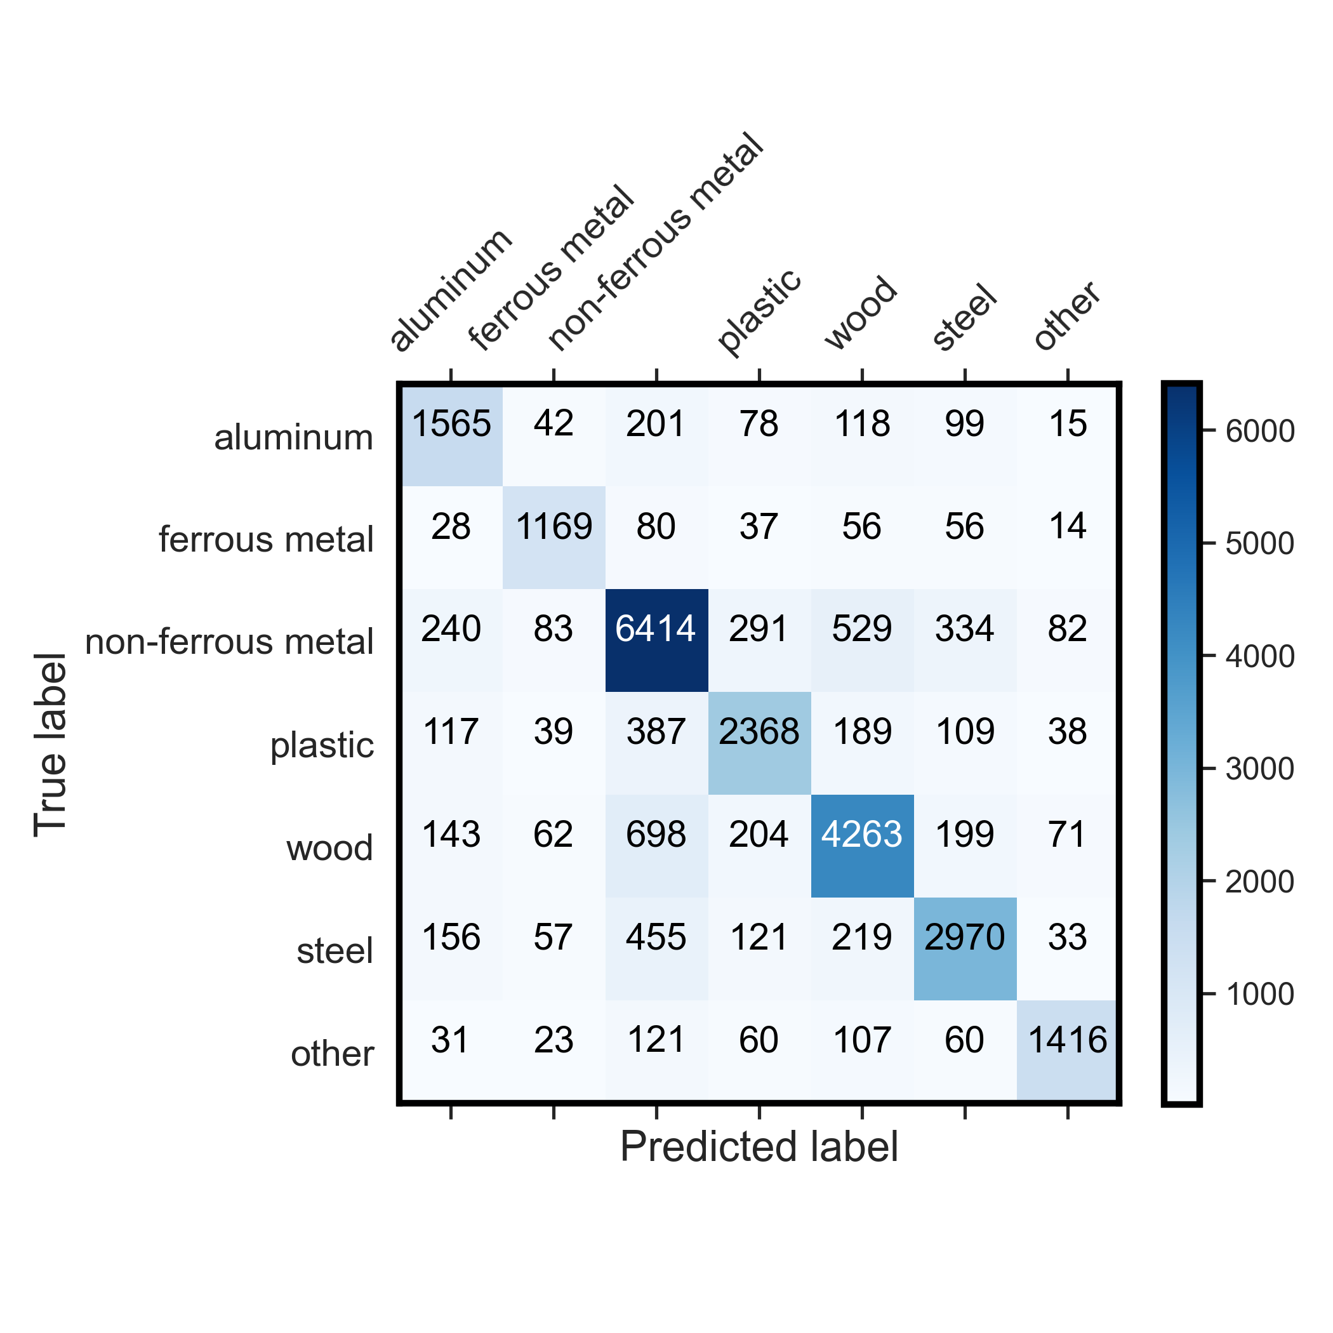
4. Results and Discussions
Random Forrest (Best performance) – Validation accuracy : 84%
Decision Tree – Validation score: 76%

Slide 25
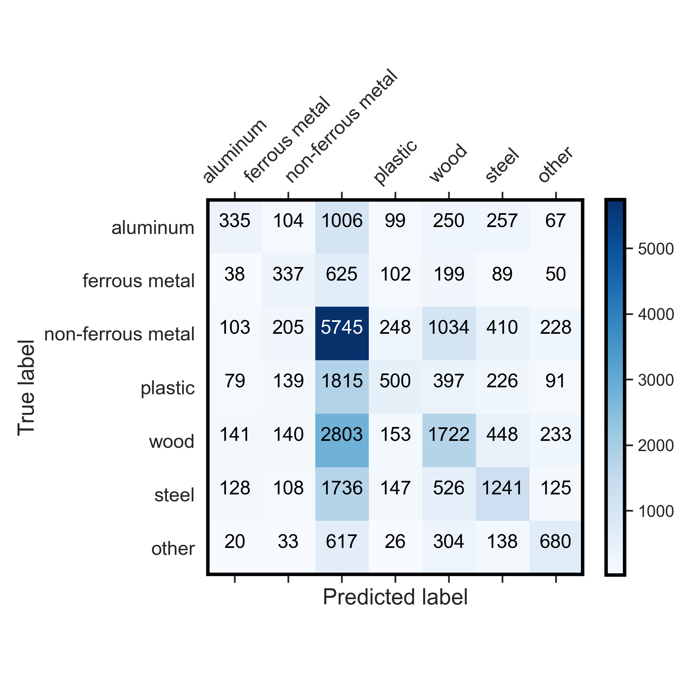

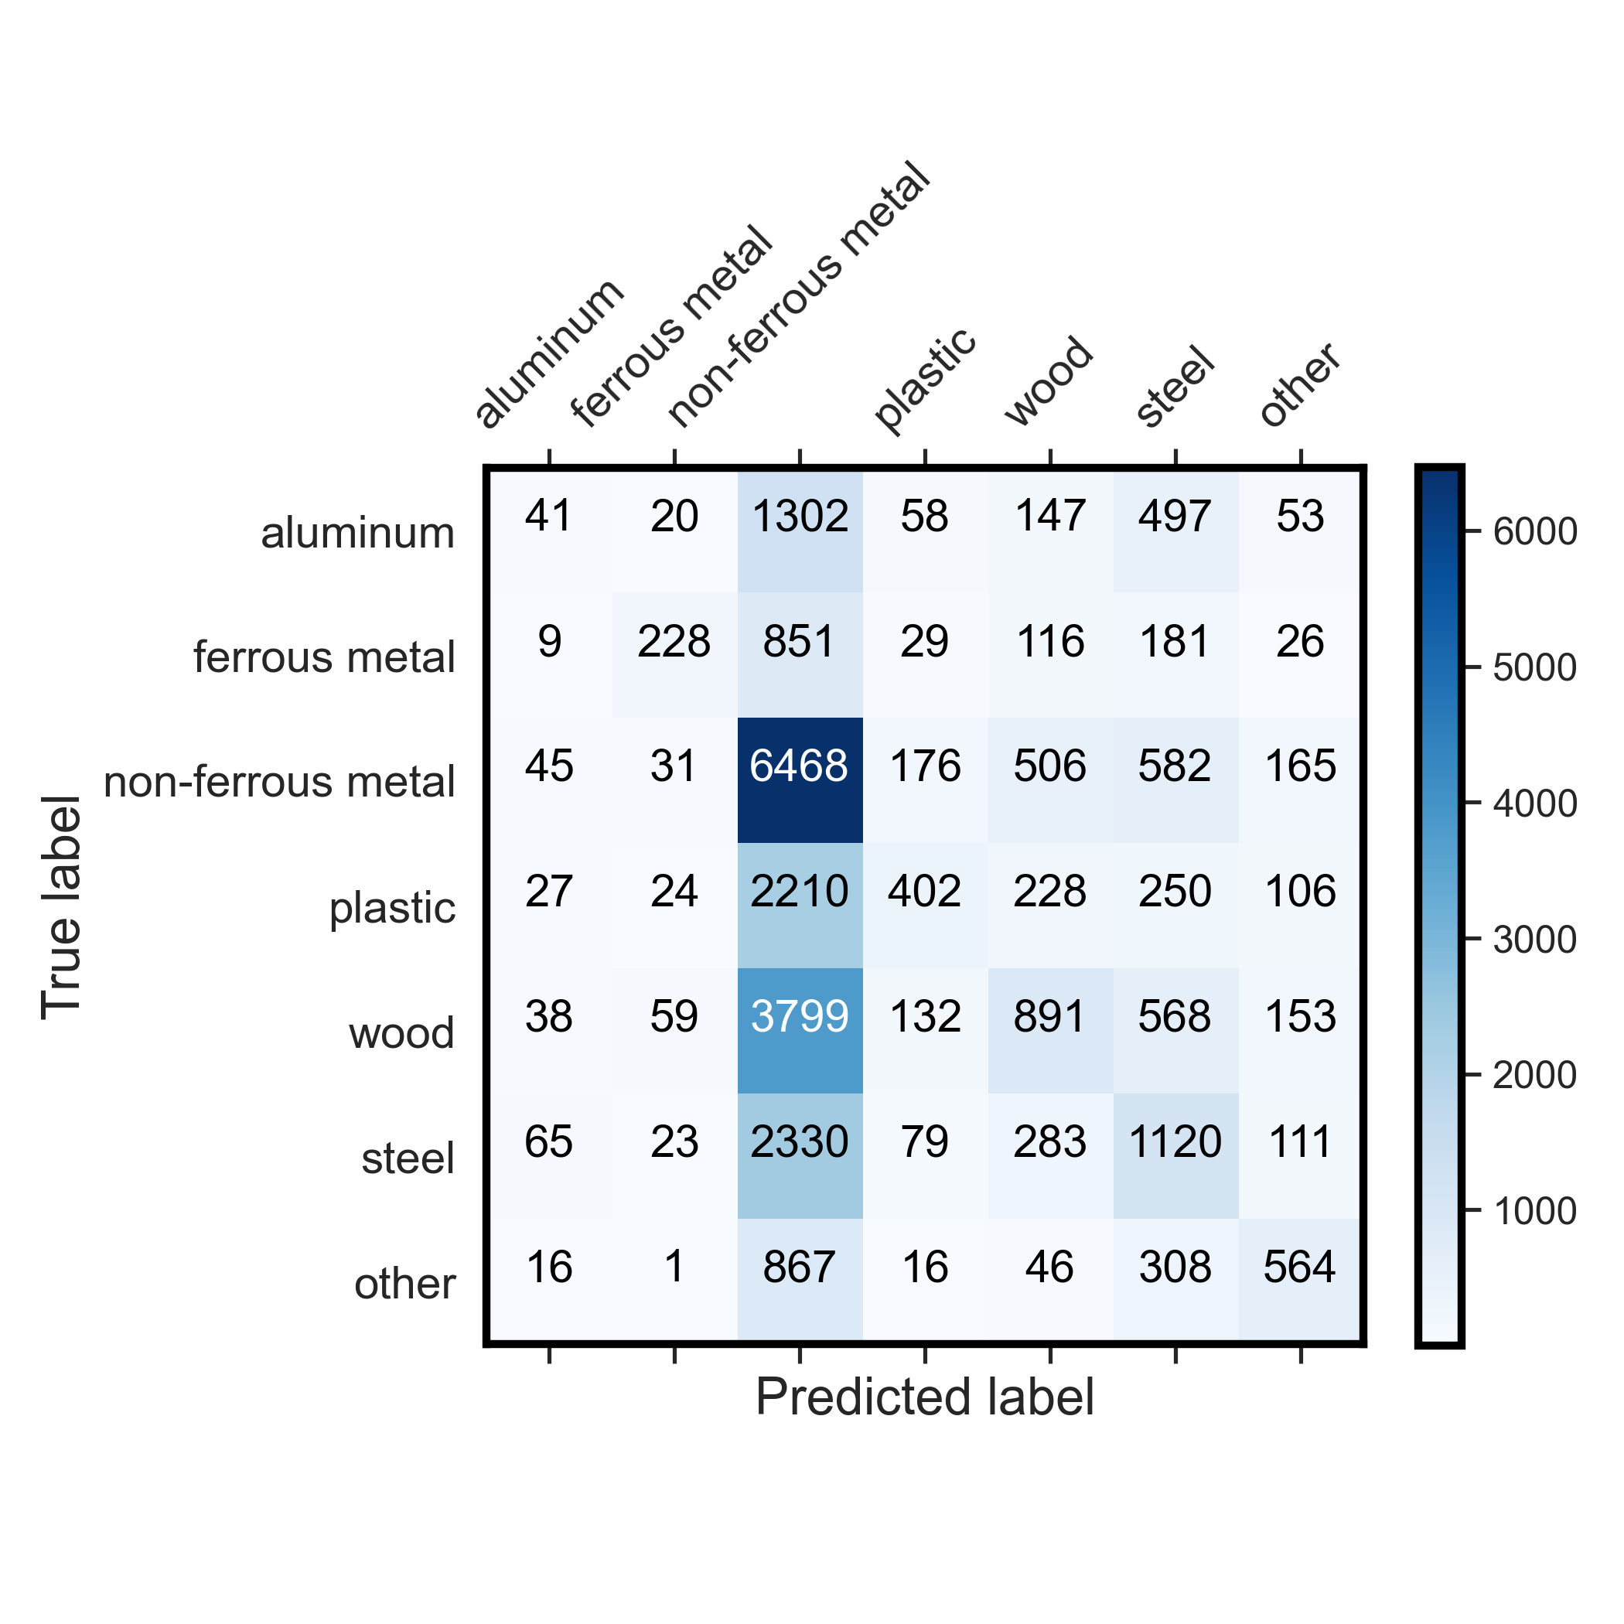
4. Results and Discussions
Adaboost – Validation score: 40%
KNN – Validation score: 68.9%
Logistic regression – Validation score: 37%

Slide 26
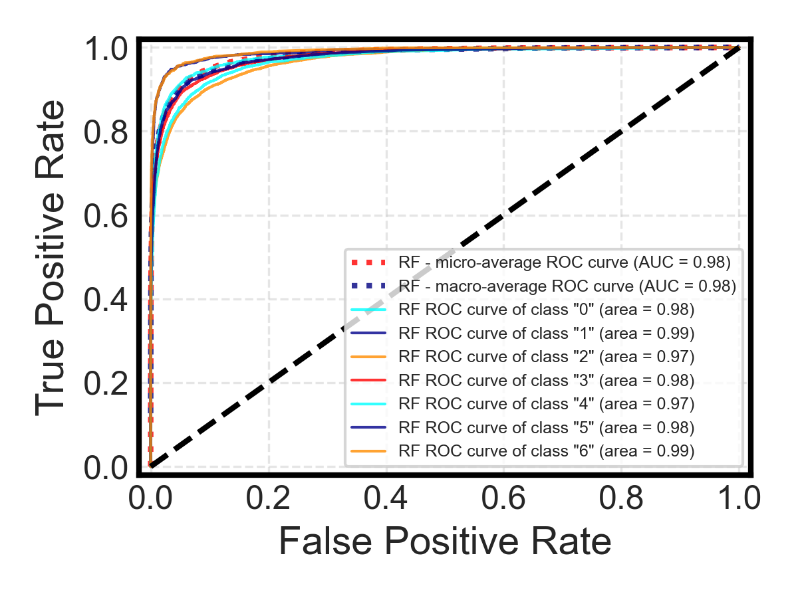
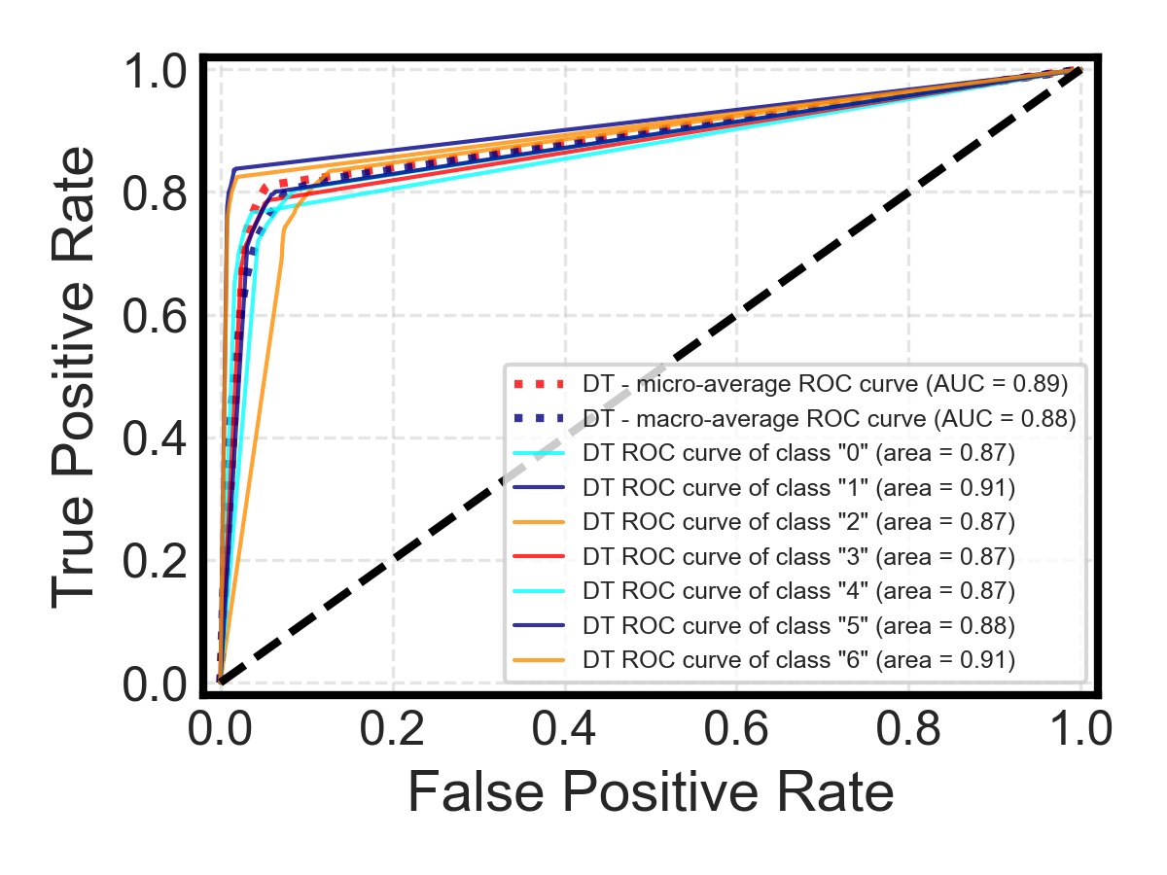
4. Results and Discussions (ROC-AUC curve)
Random Forrest (Best performance) – Validation accuracy: 84%
Decision Tree – Validation score: 76%

Slide 27
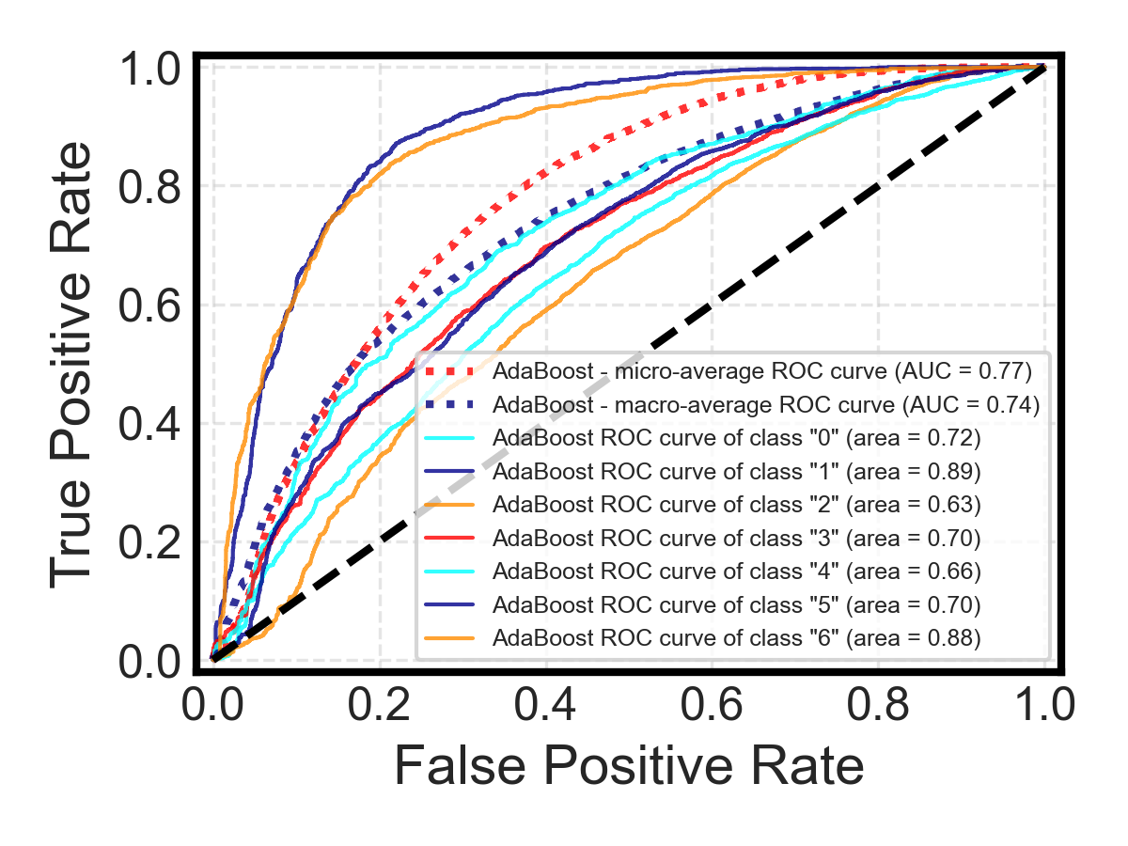
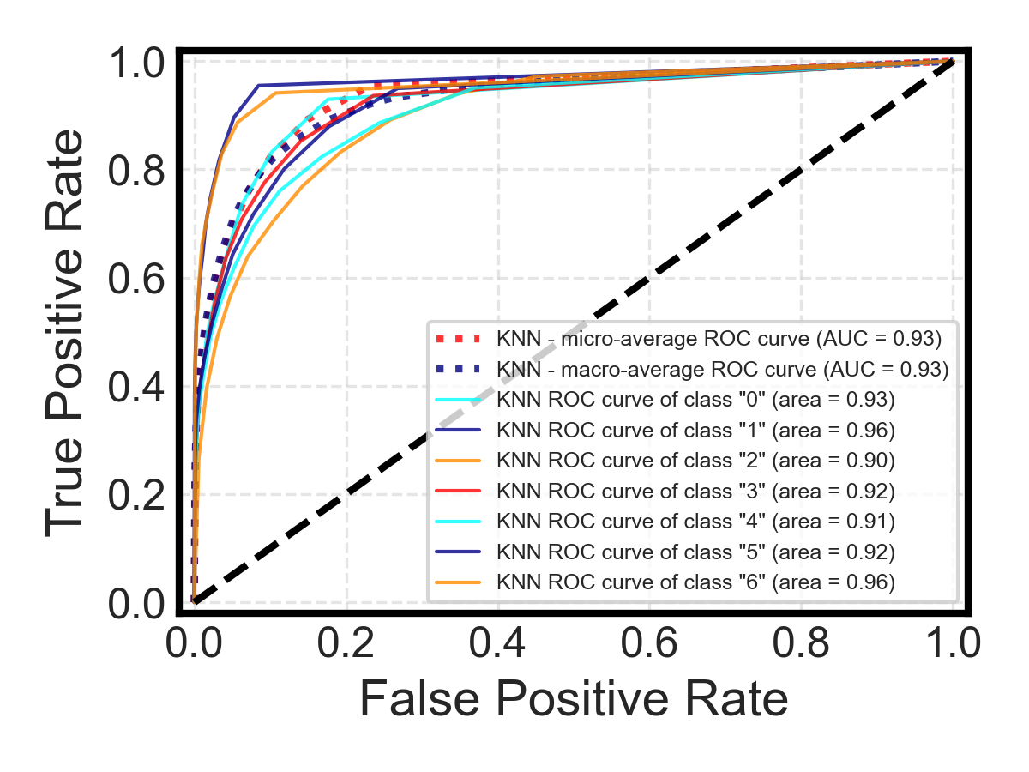
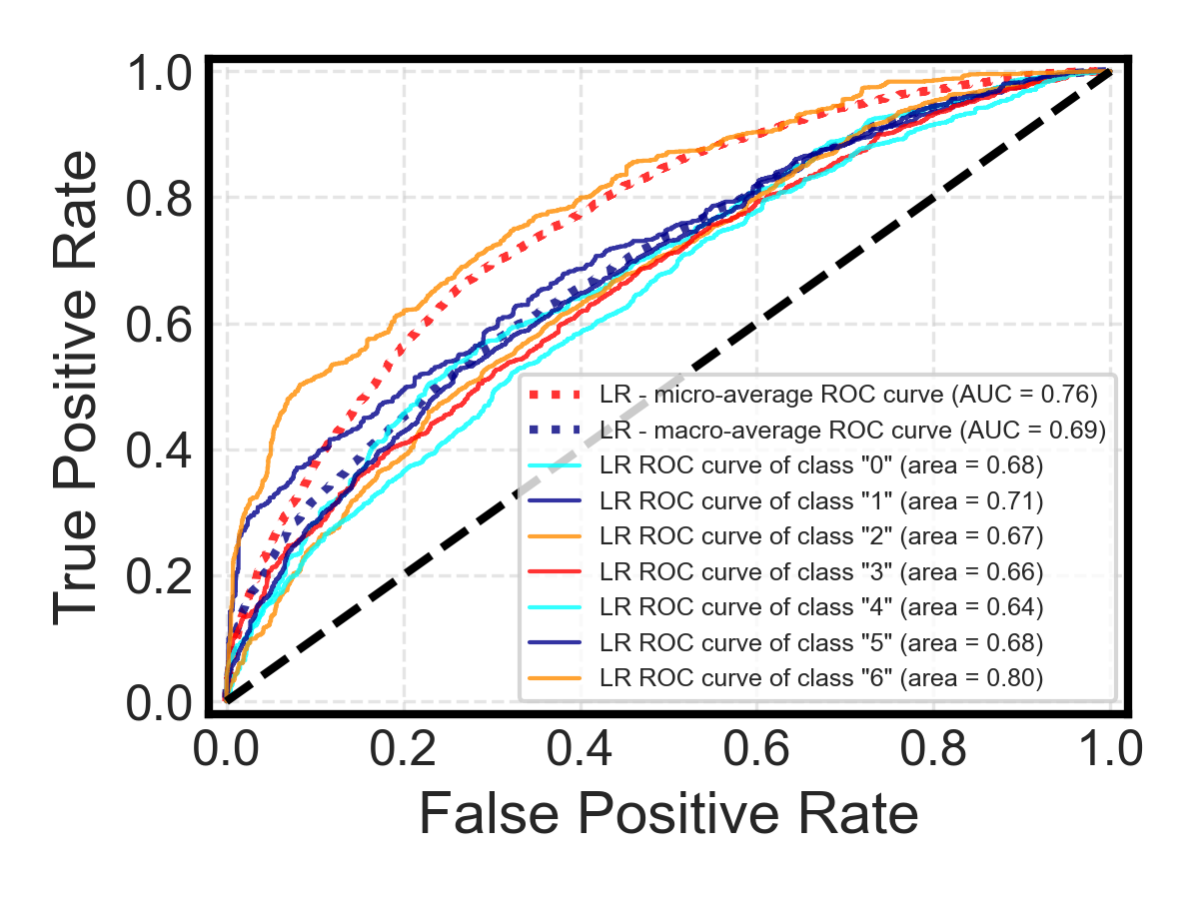
4. Results and Discussions (ROC-AUC curve)
Adaboost – Validation score: 40%
KNN – Validation score: 68.9%
Logistic regression – Validation score: 37%

Slide 28
Domain Adaptation:
Adversarial Training: Use techniques like Adversarial Domain Adaptation. These methods aim to learn representations that are invariant to domain shifts by using adversarial training. The idea is to make the feature representations from both domains (e.g., training and test) indistinguishable.
Synthetic Data Generation:
Use techniques like SMOTE (Synthetic Minority Over-sampling Technique) to generate samples that resemble the test set. This works well when you have a good idea of what the test set looks like, especially in terms of class distributions.
Weighted Loss:
If you have an idea of how the distribution of the test set differs from the training set, you can use a weighted loss function during training. For instance, if you know a particular class is underrepresented in the training set but is frequent in the test set, you can assign a higher weight to that class during training.
Ensemble Techniques:
Use ensemble methods that combine predictions from models trained on different subsets of the data or using different architectures. Sometimes, ensemble models can be more robust to distribution shifts.
Regularization:
Even though you validated on a separate set, adding some regularization might still help. Techniques like dropout, L1/L2 regularization, or early stopping can help make your model more robust.

Slide 29
5. Reflection
Key Challenges:
Insufficient time and computational resources
Lack of experience in LLM models
Investigations on hierarchical relationship within the JSON file

Slide 30







Thank you！
Q & A
Chen Lequn
PhD candidate
Advanced Remanufacturing and Technology Centre (ARTC), A*STAR, Singapore
School of Mechanical and Aerospace Engineering
Nanyang Technological University, Singapore
Contact: chen1470@e.ntu.edu.sg
Feel free to connect!

